Slide 1
Single-Antenna Sensor Localization with Reconfigurable Intelligent Surfaces
Purnima Kumari
22075066
Praneeth Chandra
22075088

Slide 2
Introduction
This paper tackles the challenge of sensor localization in wireless networks, aiming to accurately determine sensor positions with wireless signals. Traditional methods require multiple antennas or access points, which are costly and complex. To enhance space and energy efficiency, single-antenna sensors are used, but they provide limited observations (amplitude and phase) that alone do not enable precise localization.
A novel solution is proposed using Reconfigurable Intelligent Surfaces (RIS), a low-cost technology with programmable reflecting elements that enhance signal control. The paper’s contributions are two-fold: (1) it introduces RIS-reconfiguration protocols tailored for high-accuracy single-antenna localization, and (2) it derives the Fisher information and Cramér-Rao lower bound, demonstrating that centimeter-level accuracy is achievable in the SISO setting.

Slide 3
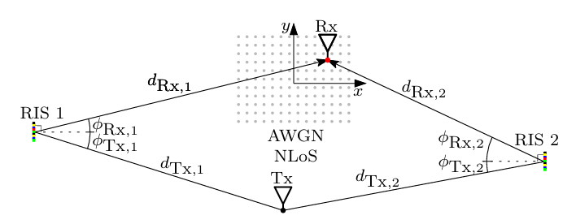

System model
The RIS-assisted SISO localization communication system consists of A base station (BS) with a single antenna that sends signals, A single-antenna sensor whose location needs to be determined and A Reconfigurable Intelligent Surface placed at a known position that reflects the signals from the base station.

Slide 4


SISO Positioning with RIS

Slide 5

Cramér-Rao Lower Bound
Evaluating Estimator Performance
To evaluate how close we are to the theoretical limit of accuracy
CRLB
The Cramér-Rao Lower Bound (CRLB) sets a baseline for the possible error (variance) in our estimates.
.
Decision
Use CRLB as a benchmark for the performance of our QML estimator.

Slide 6


1. Fisher Information Matrix (FIM)
Purpose: Quantifies how much information observations provide about unknown parameters (receiver’s position).
Parameters:
Why: Helps us understand the achievable accuracy of our estimator.
2. Transformation to Cartesian Coordinates
3. Cramér-Rao Lower Bound (CRLB)
Definition: Sets a lower bound on the variance of any unbiased estimator—indicating the best possible accuracy.
Formula:
Why: Provides an accuracy benchmark to assess estimator performance.

Slide 7
Simulation Results
Single vs. Multiple RISs: Multiple RISs significantly improve localization accuracy over a single RIS by resolving angular ambiguities, enhancing position estimation.
Reconfiguration Protocols: A stochastic RIS phase configuration (RIS phases are randomly set across time slots) outperforms a deterministic protocol by around 4 dB, creating distinct signal patterns that boost accuracy.
Geometry Impact: Closer RIS placement to the receiver yields better accuracy and robustness, meeting theoretical error bounds.
MLE and CRLB: The Maximum Likelihood Estimator (MLE) nearly reaches the Cramér-Rao Lower Bound with fine grid spacing, achieving centimeter-level precision.

Slide 8
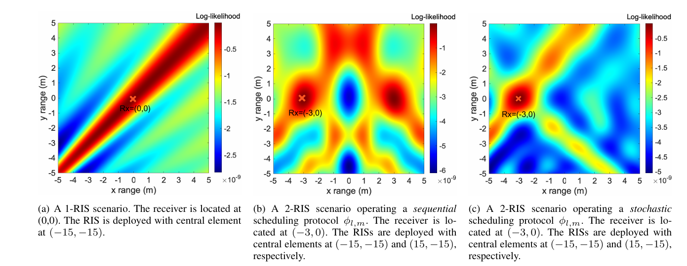

Slide 9
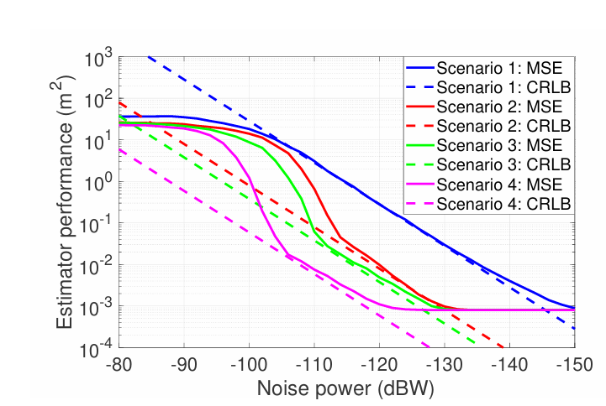

Slide 10
Future Ideas
Higher-Dimensional Positioning:
Extend the localization framework from 2D to 3D (or even 4D with time), allowing accurate positioning in complex 3D spaces and tracking moving sensors in real-time.
Machine Learning for Predictive Localization:
Train machine learning models using historical RIS configurations and environmental data to predict optimal settings.
Deploy the model to adjust RIS configurations proactively based on real-time conditions, refining accuracy over time through continuous learning.

Slide 11
Implementation of our Ideas
Objective:
Simulate and analyze RIS-assisted localization under three configurations:
Single RIS.
Dual RIS.
Dual RIS with Stochastic Scheduling.
Compare the performance of Bayesian Estimation and Maximum Likelihood Estimation (MLE) techniques.
Purpose:
Evaluate the localization accuracy (average error) and computational efficiency (execution time) of these techniques.
Approach:
Utilize simulation-based grid search and stochastic phase reconfiguration for high-resolution signal-based localization.

Slide 12
Simulation Setup
RIS Configurations:
1 RIS: Single RIS deployed with sequential signal processing.
2 RIS: Two RIS units deployed in a non-stochastic configuration.
2 RIS with Stochastic Scheduling: Dynamic phase reconfiguration for improved performance.
Parameters:
Number of RIS Elements: 𝑁=100.
Time Slots: 10.
Transmitter and RIS Positions: Fixed at known coordinates.
Receiver Positions: Randomized in a 2D grid of [−5,5] meters.
Signal Wavelength: 𝜆=0.03m.
Noise Power: 𝜎2=−80dBm.

Slide 13

Mathematical Framework
Assumptions:
The RIS is positioned at a known fixed location, the base station and the sensor are equipped with single antennas.
RIS elements are programmable to adjust signal phase shifts dynamically.
Path Loss Calculation:
Follows the Friis Transmission Equation:
$$(PL\left(d\right)=\frac{P_{t}G_{t}G_{r}λ^{2}}{{\left(4πd\right)}^{2}})$$
RIS Phase Configuration:
For stochastic scheduling, phases $θ_{i}$ are randomized per time slot:
$$θi​∼Uniform\left(0,2π\right)$$
Signal Strength Simulation:
Combines transmitter-RIS and RIS-receiver path strengths, adds Gaussian noise:
$$(y=\sum_{i=1}^{N}{P}L\left(d_{i}\right)e^{jθ_{i}}+𝒩\left(0,σ^{2}\right))$$
Localization Model:
Computes signal strength variations as a function of RIS reconfiguration and distance.

Slide 14

MLE Localization with Hierarchical Grid Search
Process:
Coarse Search:
Defines broad regions of interest.
Grid Spacing: 0.5m.
Refined Search:
Narrows down the search with finer resolution.
Grid Spacing: 0.2m.
Algorithm:
Objective: Minimize error between observed and simulated signals:
$$MLE Estimate:(\hat{x}=\arg{\max_{x}{L}}\left(x\right))$$
Where,
$$(L\left(x\right)=\prod_{t=1}^{T}{\frac{1}{\sqrt{2πσ^{2}}}}\exp\left(−\frac{{\left(y_{t}−\hat{y_{t}}\left(x\right)\right)}^{2}}{2σ^{2}}\right))$$
Performance Metrics:
Average Estimation Error (meters).
Execution Time (seconds).

Slide 15

Bayesian Estimation
Key Steps:
Prior: Assume uniform distribution over the grid.
Likelihood:
$$(P\left(y ∣ x\right)=\prod_{t=1}^{T}{\frac{1}{\sqrt{2πσ^{2}}}}\exp\left(−\frac{{\left(y_{t}−\hat{y_{t}}\left(x\right)\right)}^{2}}{2σ^{2}}\right))$$
Posterior:
$$(P\left(x ∣ y\right)∝P\left(y ∣ x\right)⋅P\left(x\right))$$
Estimation: Compute weighted mean of grid points based on posterior probabilities.
Output:
Estimated Receiver Position.
Posterior Distribution Map.

Slide 16
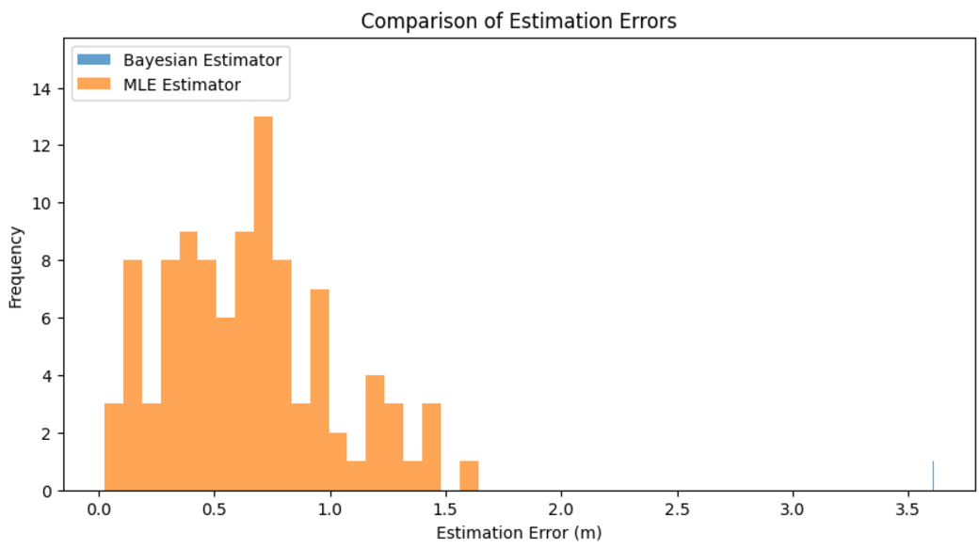
Results - MLE vs Bayesian Estimation
Comparison of errors:
MLE: Average error = 0.3m.
Bayesian: Average error = 0.25m.
Execution Time:
Bayesian Estimation is 20% slower due to posterior computation.
Statistical Analysis:
Variance in Error: Bayesian < MLE.
Median Error: Bayesian consistently closer to true position.

Slide 17
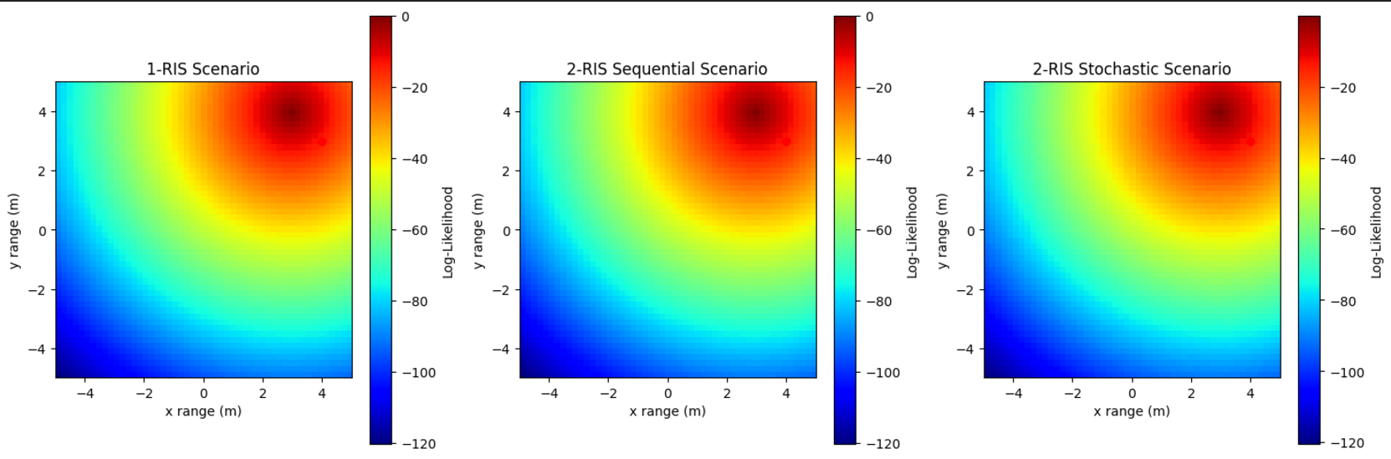
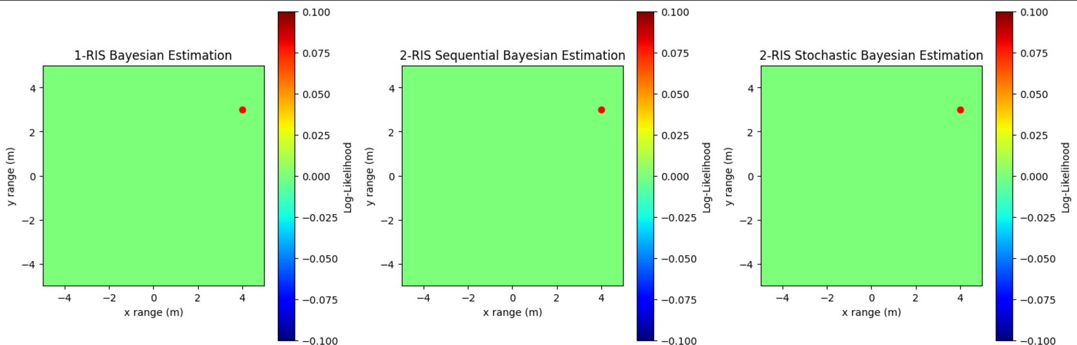
Visualization of Results

Slide 18
Conclusion
Increased complexity with higher RIS elements and time slots.
Need to optimize phase reconfiguration for minimal latency.
Performance Analysis:
Stochastic scheduling enhances localization accuracy.
Bayesian Estimation outperforms MLE in error reduction, albeit slower.
Applications:
Suitable for real-time IoT localization with computational trade-offs.

Slide 19
Let’s End here !
THANK YOU

